Slide 1


CITS1003 Introduction to Cybersecurity [3] Introduction to Computer Architecture
Dr David Glance

Slide 2
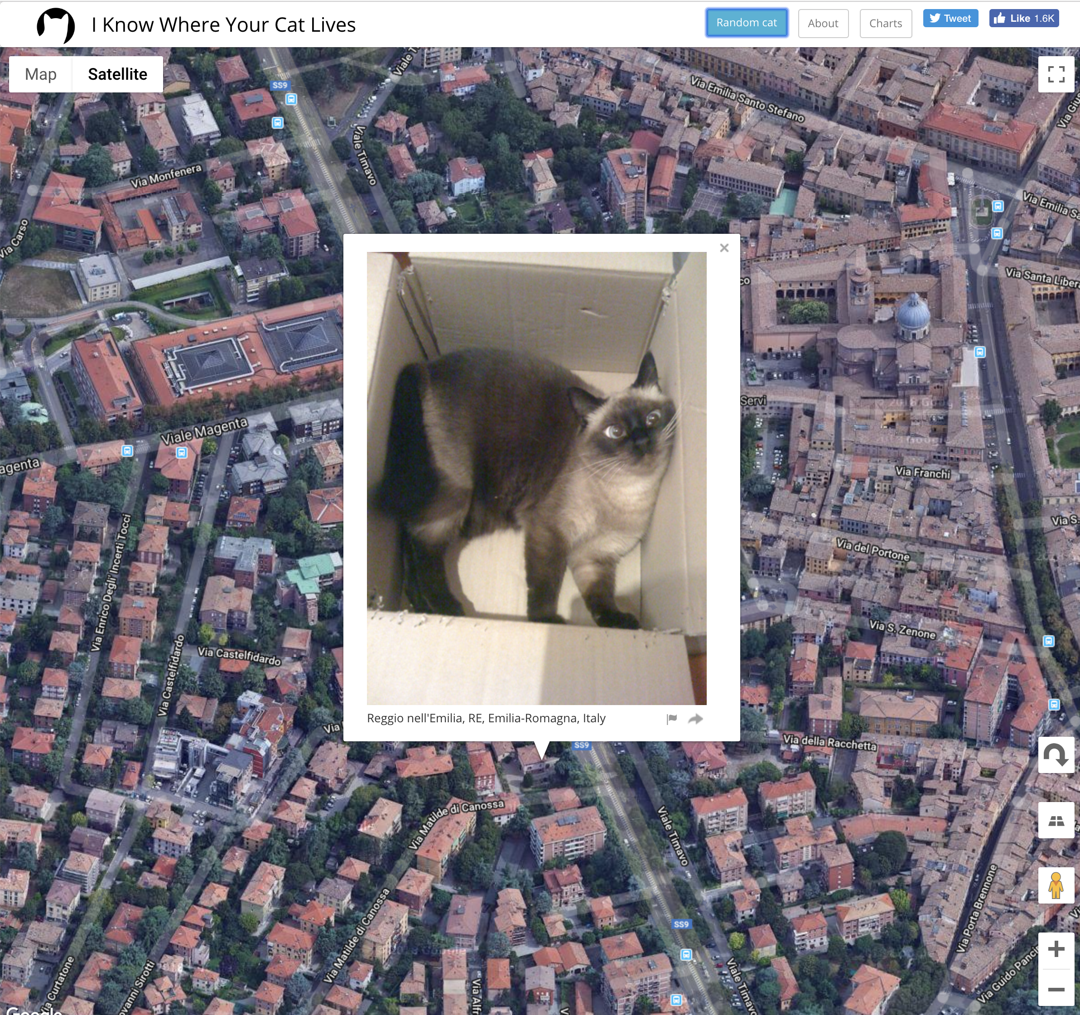
A unit about cats cybersecurity
I Know Where Your Cat Lives
https://iknowwhereyourcatlives.com/

Slide 3

Three things
Fundamentals and language of computer hardware and operating systems
How operating systems implement security
Fundamentals of networking and network security

Slide 4
Computers and Networks
Although we are focussed on general ideas around Cybersecurity, it is useful to at least have some understanding of computers and the networks they use to communicate over
We will look at PC architecture first in a generalised way and then the basics of how computer networks operate, especially TCP/IP, the network protocol of the Internet

Slide 5
PC Architecture
At one level of abstraction, a PC’s purpose is to run software applications
Applications are run by an Operating System: e.g. Windows, Linux MacOS
Before an Operating System can run, it needs to be loaded and started and this is the job of firmware or a “bootloader”. Firmware exists in devices like hard drives, network cards, sound cards, etc
This is all running on hardware: the components of the PC that store, execute and process inputs and outputs
Applications
Operating System
Firmware
Hardware

Slide 6
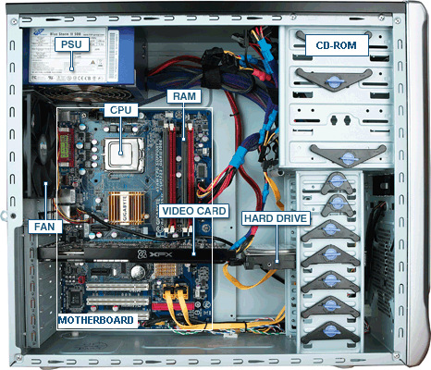
PC Hardware
CPU: Central processing unit
RAM: Random Access Memory
PSU: Power Supply Unit
Fan: Fan
Video Card
Hard Drive
Motherboard
Network card: Wired and/or Wireless (not shown)
http://tazalink.blogspot.com/

Slide 7
CPU
The CPU processes instructions and data that are stored in memory
Memory is either random access memory (RAM) or read only memory (ROM)
Instructions and data are transported between memory and the CPU over a Bus. Either:
Address Bus
Data Bus
Control Bus
The CPU can also read and write data from an Input/Output (I/O) device
Instructions that are processed by the CPU are simple operations like add, subtract, AND, OR, XOR, etc

Slide 8
Booting Up
When a computer is powered on, the firmware in ROM is loaded and run. This is the BIOS (Basic Input Output System).
The BIOS will run a Power-On Self Test (POST) to check for hardware components like a display, keyboard, network card, memory.
The BIOS will then load the first 512 bytes from the hard drive called the Master Boot Record (MBR) This contains the bootloader code that will execute and load the operating system

Slide 9
Operating System
The operating system is responsible for a number of different tasks
Running and scheduling applications to run and share resources such as CPU, Disk, RAM
Allows for memory virtualization
Controlling access to I/O devices through I/O Driver software
Manage access control and authentication
Handle communication via networks
Handles graphical user interfaces

Slide 10
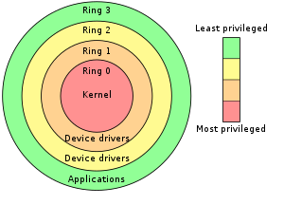
Kernel
The CPU operates in different modes: user mode and supervisor mode
Applications are run in different protective rings organised from the most secure and privileged in Ring 0 to application level code in Ring 4
Applications that are scheduled to run are prioritised depending on which ring they run in: Most privileged applications have priority
Organising the kernel in Ring 0 is a protection mechanism to allow only trusted code to run there

Slide 11
File Systems
A file:
Is a named collection of information stored on a storage device such as a internal disk drive or external USB drive
Has metadata such as name, type, location, size, protection, creator, creation time, etc
Has an owner and permissions for access control
Organised in directories or folders
Operating system supports a file system which is a way of organising files on a disk, providing operations of creating, reading, writing and deleting files
Devices can be logically viewed as files as well
Numerous file system types: FAT, NTFS, APFS, EXT etc
Access is controlled by discretionary and role based access control

Slide 12
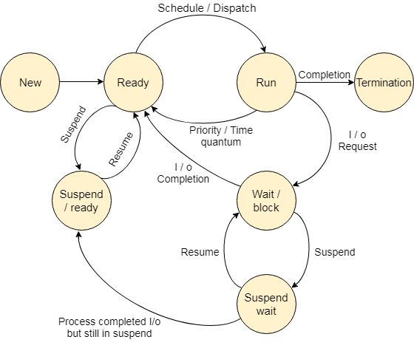
Processes
The operating system is responsible for running programs and managing their access to system resources
When a program is running it is known as a process and multiple processes may be running at the same time
The process may be in a number of different states depending on what actions it is performing or whether it has used up its time quantum

Slide 13
Process States
State | Description
Start | This is the initial state when a process is first started/created.
Ready | The process is waiting to be assigned to a processor. Ready processes are waiting to have the processor allocated to them by the operating system so that they can run. Process may come into this state after Start state or while running it by but interrupted by the scheduler to assign CPU to some other process.
Running | Once the process has been assigned to a processor by the OS scheduler, the process state is set to running and the processor executes its instructions.
Waiting | Process moves into the waiting state if it needs to wait for a resource, such as waiting for user input, or waiting for a file to become available.
Exit | Once the process finishes its execution, or it is terminated by the operating system, it is moved to the terminated state where it waits to be removed from main memory.
Processes are scheduled by the operating system according to one of a number of different algorithms
Processes may run at the same time if the computer has multiple processors
Simultaneous execution can happen through multithreading
A lightweight version of a process

Slide 14
Process Attributes
Process ID (pid): A process is uniquely identified by a numeric identifier
Parent: All processes are started by another process and so maintains links to their parent and may inherit attributes such as open files and access to terminals
Parent processes are identified by the Process Parent ID (ppid)
Files: Processes work on files (and devices that are represented as files) and so information about these are kept for each process
Virtual Memory: A process is allocated memory to store the code and data that it operates on. If this becomes too large for physical memory, it may be mapped to disk

Slide 15
Access Control
Access control restricts who has access to an object (e.g. file) and what operations they may perform on it. Different types:
Discretionary Access Control (DAC)
Mandatory Access Control (MAC)
Role-Based Access Control (RBAC)
Rule-Based Access Control
Attribute Based Access Control

Slide 16
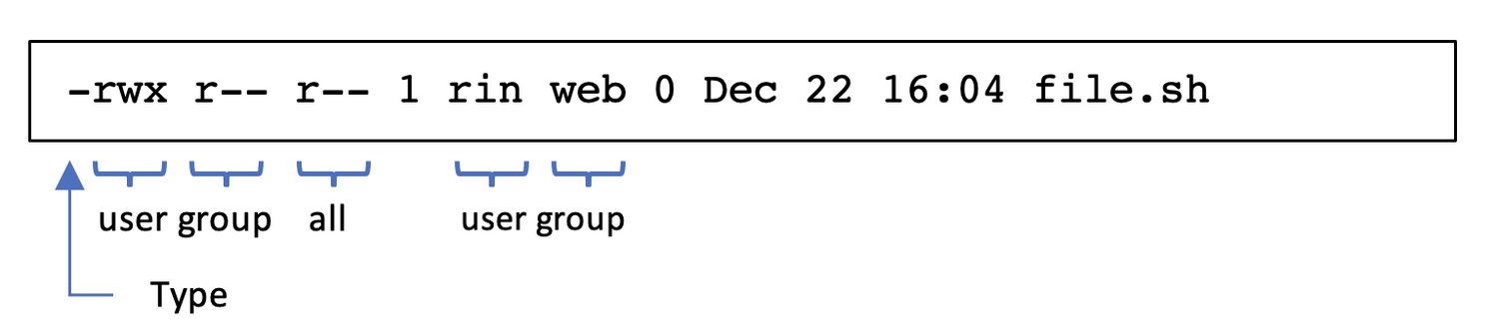
DAC and RBAC
Discretionary Access Control (DAC): Each object has an owner who grants access to other users
Linux and Windows file systems use this along with role based access control
Role-Based Access Control (RBAC): Access is granted by administrators to groups of users based on their roles
In Linux: operations are r (read), w (write), x (execute) and are set on each file and directory

Slide 17
Rules, ABAC and MAC
Rule-Based Access Control: Access is granted based on rules/policies
Firewalls use this type of access control
Cloud Services object storage also uses policies to grant access
Attribute Based Access Control (ABAC): Access granted based on attributes (device, location, time of day)
Networks such as WiFi that restrict access based on MAC address or time of day
”Allow access from mobile devices”
Mandatory Access Control (MAC): Access is granted based on labels assigned to the user and the object.
Used in situations were access is determined by security level e.g. Top Secret vs Secret

